Slide 1

Webservices (SOAP + REST)

Slide 2
Table of Contents
Day | Modules | Topics
Day 1 | Module 1 | Introduction to Web Services and alternatives
 | Module 2 | Styles of Web Services
 | Module 3 | SOAP
 | Module 4 | WSDL
 | Module 5 | Developing SOAP Web Service
 | Module 6 | Introduction to REST
 | Module 7 | Getting Started with JAX-RS Service
 | Module 8 | SOA Concepts

Slide 3
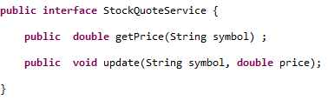
Simple Scenario
Want to expose the implementation of below interface as a soap webservice

Slide 4
What is a Webservice ?
What do I mean by a webservice ?
Web services are made available from a business's Web server for Web users or other Web-connected programs.
Unlike traditional client/server models, Web services do not provide the user with a GUI .
Web services instead share business logic, data and processes through a programmatic interface across a network.

Slide 5
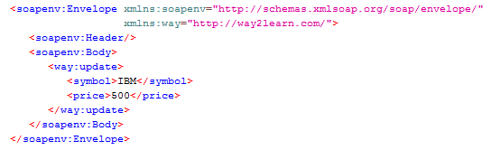
SOAP
XML data which should be exchanged between client and server should be in a particular format.
SOAP is a standard message protocol which defines the format of exchanged data.
Sample SOAP Xml for making request to update of StockQuoteService :

Slide 6
Styles of Webservices
Following are styles of Webservices :
Rpc Style
Document Style

Slide 7
RPC Style Webservices
In RPC Style webservices, one input message can contain more than one part.
If above is the input message for accessing, RPC style webservice, <way:update> identifies operation name and parts are symbol and name

Slide 8
Document Style Webservices
In Document Style Webservices, input message contain only a single part.
If the method being invoked takes more than one argument, the single part in input message is a complex type defined in the schema

Slide 9
RPC vs Document style
In Document style Webservices, the input message tag are defined in XSD. So, the incoming messages can be validated against XSD before processing the message
In RPC style Webservices, the incoming messages does not contain and xsd. So, they cannot be validated
So, Document style is preferred over RPC Style

Slide 10
How to describe about our service to client?
We describe a webservice to client in a WSDL file.
WSDL stands for webservice definition language
WSDL is an XML-based language for describing Web services and how to access them.

Slide 11
A WSDL document describes a web service using these major elements:
<types> →The data types used by the web service
<message> →The messages used by the web service
<portType> →The operations performed by the web service <binding> →The communication protocols used by the web service

Slide 12
Main structure of a WSDL document looks like this:
<definitions> <types> definition of types........ </types> <message> definition of a message.... </message> <portType> definition of a port....... </portType> <binding> definition of a binding.... </binding> </definitions>

Slide 13
WSDL Types
The <types> element defines the data types that are used by the web service.
For maximum platform neutrality, WSDL uses XML Schema syntax to define data types.

Slide 14
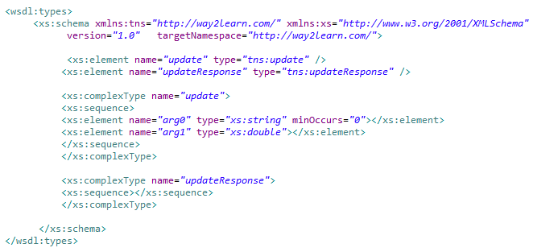
Example for Wsdl:types

Slide 15


WSDL Messages
The <message> element defines the data elements of an operation.
Each message can consist of one or more parts.
The parts can be compared to the parameters of a function call in a traditional programming language.

Slide 16
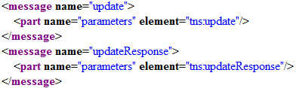
Example for message definition
What does tns:update refer to

Slide 17

Code First Webservice

Slide 18
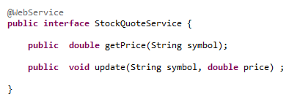

Slide 19
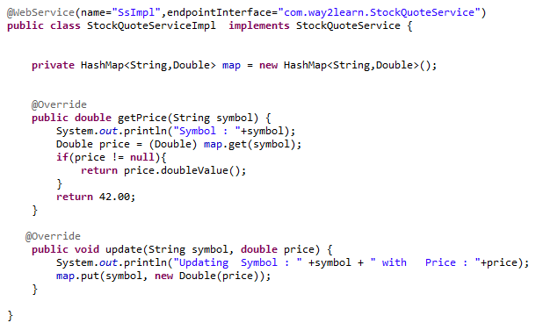

Slide 20
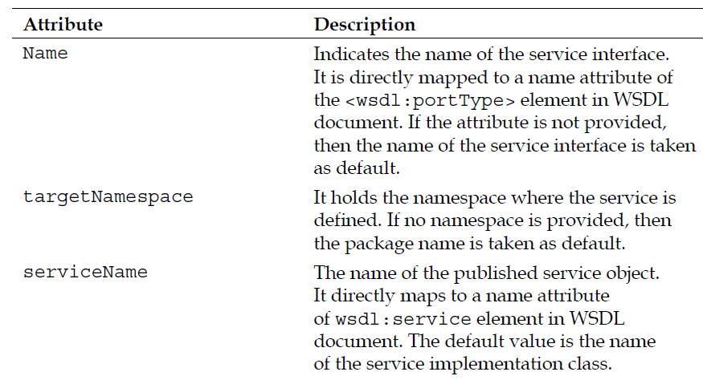
@WebService attributes

Slide 21
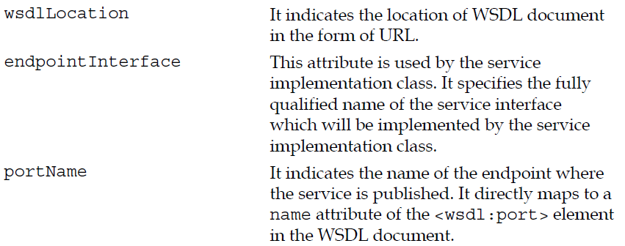
@WebService attributes

Slide 22
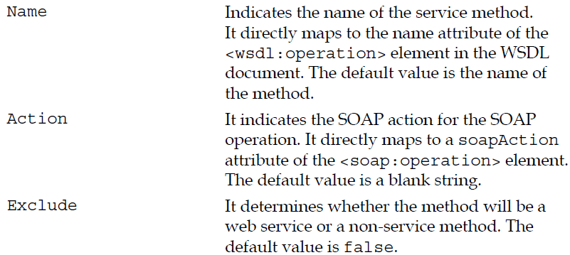
javax.jws.WebMethod
The @WebMethod annotation supports the following attributes:

Slide 23
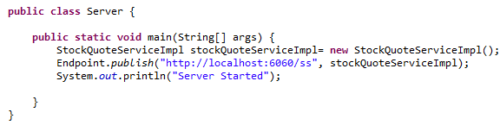
Publishing a Webservice

Slide 24
Looking at wsdl
Give a request to the following URL :
http://localhost:6060/ss?wsdl

Slide 25
SOAP UI
Send a request using SOAP UI

Slide 26
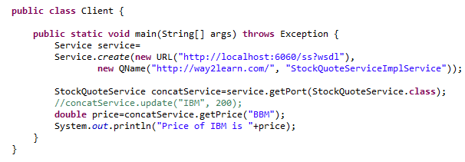
Consuming a webservice

Slide 27
Introduction to REST

Slide 28

Restful Webservices
REST is not protocol-specific .
When people talk about REST, they usually mean
REST over HTTP.
REST uses HTTP extensively.
Non-RESTful technologies like SOAP and WS-* use HTTP strictly as a transport protocol and thus use a very small subset of its capabilities.

Slide 29
RESTful Architectural Principles

Slide 30
Http
you don’t have an “action” parameter in your URI and use only the methods of HTTP for your web services.
Following are the HTTP methods :
GET
PUT
DELETE
POST
HEAD
OPTIONS

Slide 31
GET
GET is a read-only operation. It is used to query the server for specific information.
It is both an idempotent and safe operation
Idempotent means that no matter how many times you apply the operation, the result is always the same.
Safe means that invoking a GET does not change the state of the server at all.

Slide 32
PUT
PUT requests that the server store the message body sent with the request under the location provided in the HTTP message.
It is usually modeled as an insert or update.
It is also idempotent.
When using PUT, the client knows the identity of the resource it is creating or updating. It is idempotent because sending the same
PUT message more than once has no effect on the underlying service.
An analogy is an MS Word document that you are editing. No matter how many times you click the Save button, the file that stores your document will logically be the same document.

Slide 33
DELETE
DELETE is used to remove resources.
It is idempotent as well.

Slide 34
POST
POST is the only nonidempotent and unsafe operation of HTTP.
Each POST method is allowed to modify the service in a unique way.
You may or may not send information with the request.
You may or may not receive information from the response.

Slide 35
HEAD
HEAD is exactly like GET except that instead of returning a response body, it returns only a response code and any headers associated with the request.

Slide 36
OPTIONS
OPTIONS is used to request information about the communication options of the resource you are interested in.
It allows the client to determine the capabilities of a server and a resource without triggering any resource action or retrieval.

Slide 37
Example

Slide 38

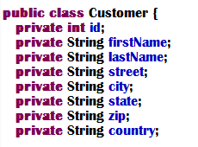

Slide 39
Model the URIs
In a RESTful system, endpoints are usually referred to as resources and are identified using a URI.
URIs satisfy the addressability requirements of a RESTful service.
Here is a list of URIs that will be exposed in our system:
/customers
/customers/{id}
The /customers URI represents all the customers in our system.
To access an individual customer ,we will use a pattern: /customers/{id}.

Slide 40
Defining the Data Format

Slide 41
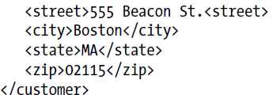
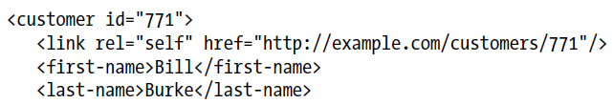
Read and Update Format

Slide 42

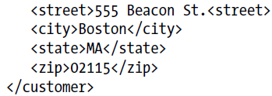
Create Format

Slide 43
Assigning HTTP Methods

Slide 44
Assigning HTTP Methods
It is crucial that we do not assign functionality to an HTTP method that supersedes the specification-defined boundaries of that method.
For example, an HTTP GET on a particular resource should be read only.
It should not change the state of the resource it is invoking on. Intermediate services like a proxy-cache, or your browser rely on you to follow the semantics of HTTP strictly so that they can perform built-in tasks like caching effectively.
If you do not follow the definition of each HTTP method strictly, clients
and administration tools cannot make assumptions about your services and your system becomes more complex.

Slide 45
Assigning HTTP Methods
To get a list of Customers, the remote client will call an HTTP GET
on the URI of the object group it is interested in.
An example request would look like the following:
GET /customers HTTP/1.1
One problem with this bulk operation is that we may have thousands of Customers in our system and we may overload our client and hurt our response time.
So we may use :
GET /customers?startIndex=0&size=5 HTTP/1.1

Slide 46
Obtaining Individual entities
/customers/{id}
Eg :
GET /customers/232 HTTP/1.1

Slide 47
Creating with PUT
The HTTP definition of PUT states that it can be used to create or update a resource on the server
Eg:
PUT /customers/112 HTTP/1.1
Content-Type: application/xml

Slide 48
PUT is required by the specification to send a response code of 201, “Created” if a new resource was created on the server as a result of the request.
The HTTP specification also states that PUT is idempotent.
Our PUT is idempotent, because no matter how many times we tell the server to “create” our Order, the same bits are stored at the /customers/112 location.

Slide 49
Sometimes a PUT request will fail and the client won’t know if the request was delivered and processed at the server.
Idempotency guarantees that it’s OK for the client to retransmit the PUT operation and not worry about any adverse side effects.
The disadvantage of using PUT to create resources is that the client has to provide the unique ID that represents the object it is creating.
If we want ID to be generated by the server, we can use POST.

Slide 50
Creating With POST
To create a Customer with POST, the client sends a representation of the new object it is creating to the parent URI of its representation,
leaving out the numeric target ID.
POST /customers HTTP/1.1
Content-Type: application/xml

Slide 51

What if the client wants to edit, update, or cancel the order it just posted?
What is the ID of the new order?
To resolve this issue, we will add a bit of additional information to the HTTP response message.
HTTP/1.1 201 Created
Content-Type: application/xml
Location: http://example.com/customers/771

Slide 52
HTTP requires that if POST creates a new resource that it respond with a code of 201, “Created” (just like PUT).
The Location header in the response message provides a URI
to the client so it knows where to further interact with the Customer that was created, i.e., if the client wanted to update the Customer.
It is optional whether the server sends the representation of the newly created Order with the response.

Slide 53
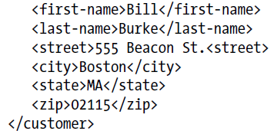
Updating a Customer
PUT /customers/117 HTTP/1.1
Content-Type: application/xml
When a resource is updated with PUT, the HTTP specification requires that you send a response code of 200, “OK” and a response message body or a response code of 204,
“No Content” without any response body

Slide 54
Deleting a customer
The client simply invokes the DELETE method on the exact URI that represents the object we want to remove.
When a resource is removed with DELETE, the HTTP specification requires that you send a response code of 200, “OK” and a response message body or a response code of 204, “No Content” without any response body.

Slide 55
Cancelling an Order
While removing an object wipes it clean from our databases, cancelling only changes the state of the Order and retains it within the system.
How should we model such an operation?

Slide 56
Overloading the meaning of DELETE
Cancelling an Order is very similar to removing it.
One thing we could do is add an extra query parameter
to the request:
DELETE /orders/233?cancel=true HTTP/1.1
It is not good RESTful design as you are changing the meaning of the uniform interface.
Using a query parameter in this way is actually creating a mini-RPC mechanism.
HTTP specifically states that DELETE is used to delete a resource from the server, not cancel it.

Slide 57
States versus operations
When modelling a RESTful interface for the operations of your object model, you should ask yourself a simple question:
is the operation a state of the resource?
If you answer yes to this question, the operation should be modeled within the data format.

Slide 58
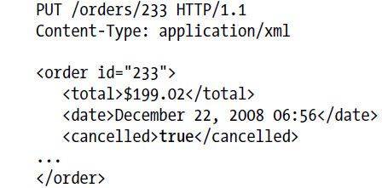
Since the state of being cancelled is modeled in the data format, we can now use our already defined mechanism of updating an Order to model the cancel operation.
For example, we could PUT this message to our service:

Slide 59
Using Subresource
What if we expanded on our cancel example by saying that we wanted a way to clean up all cancelled orders?
We can’t really model purging the same way we did cancel.
To solve this problem, we model this operation as a sub resource of /orders and we trigger a purging by doing a POST on that resource. For example:
POST /orders/purge HTTP/1.1

Slide 60
An interesting side effect of this is that because purge is now a URI, we can evolve its interface over time.
For example, maybe GET /orders/purge returns a document that
states the last time a purge was executed and which orders were deleted.
What if we wanted to add some criteria for purging as well?
Form parameters could be passed stating that we only want to purge orders older than a certain date.

Slide 61
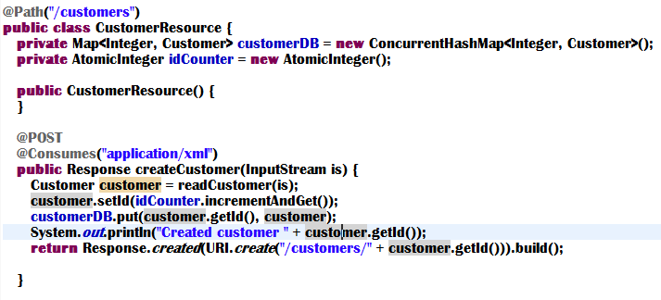

Slide 62
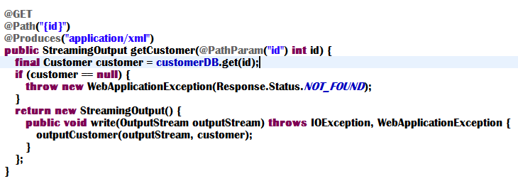

Slide 63
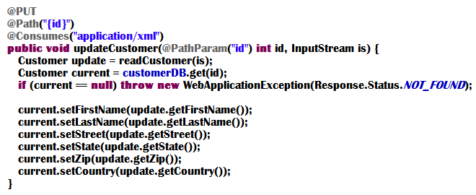

Slide 64
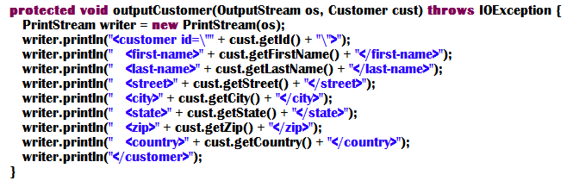

Slide 65
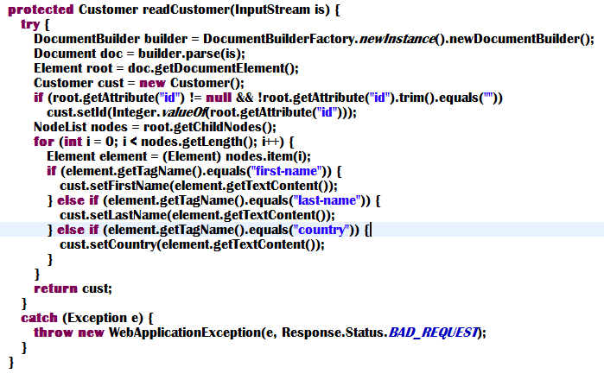

Slide 66
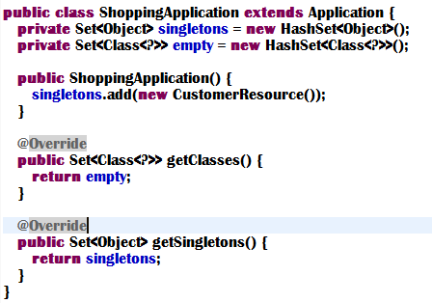

Slide 67
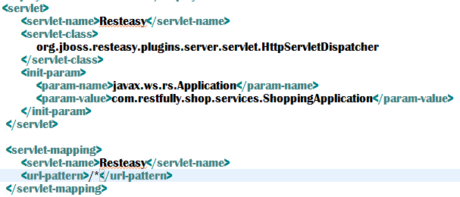

Slide 68
Using CXF without server

Slide 69
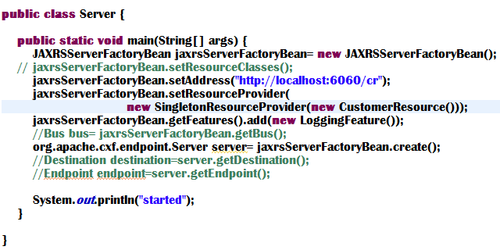

Slide 70
The JAXRSServerFactoryBean creates a Server inside CXF which starts listening for requests on the URL specified.
setResourceClasses() is for root resources only, use setProvider() or setProviders() for @Provider-annotated classes.
By default, the JAX-RS runtime is responsible for the lifecycle of resource classes, default lifecycle is per-request. You can set the lifecycle to singleton by using following line:

Slide 71
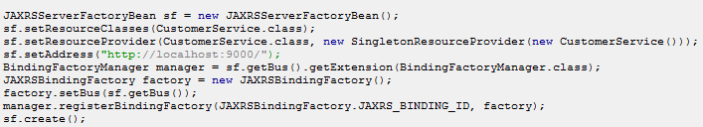
Configuring JAX-RS endpoints programmatically without Spring
Even though no Spring is explicitly used in the previous configuration, it is still used by default to have various CXF components registered with the bus such as transport factories.
If no Spring libraries are available on the classpath then follow the following example :

Slide 72
SOA Concepts
SOA is an architecture approach for defining, linking, and integrating reusable business services that have clear boundaries and are self-contained with their own functionalities. Within this type of architecture, you can orchestrate the business services in business processes. Adopting the concept of services—a higher-level abstraction that's independent of application or infrastructure IT platform and of context or other services—SOA takes IT to another level, one that's more suited for interoperability and heterogeneous environments.

Slide 73
Introducing Terminology
Business Processes
Services
Service-Oriented Architecture

Slide 74
Services
Physically independent software programs with distinct design characteristics that facilitate
Loose coupling
Reusability
Composition
Discovery
through a standardized service contract.

Slide 75
Service Compositions
Coordinated aggregate or assembly of services to provide the functionality required to automate a specific business task or process.
Services with functional contexts that are agnostic to any one business process are capable of participating in multiple service compositions.
Business
Process
A
Business
Process
B
Business
Process
C
Business
Process
D
Business
Process
E
Business
Process
F
Business Process Agnostic Services

Slide 76
Service Inventory
An independently standardized and governed collection of complementary services.
A single, enterprise-wide inventory, or multiple service inventories, each of which may be individually standardized, governed, and supported by its own service-oriented technology architecture.
Typically created through top-down delivery processes.
Application of service-oriented design principles and custom design standards through a service inventory is important to establish a high degree of inter-service interoperability.

Slide 77
Service-Oriented Architecture
Technology architecture designed to support service-oriented solution logic, comprising services and service compositions.
Standards-based platform that allows services to be developed, discovered and consumed by each other, to facilitate the creation of an orchestrated business process.
Notes:
Logic required to solve a large and complex problem can be developed better if it is decomposed in a number of smaller, related pieces.

Slide 78
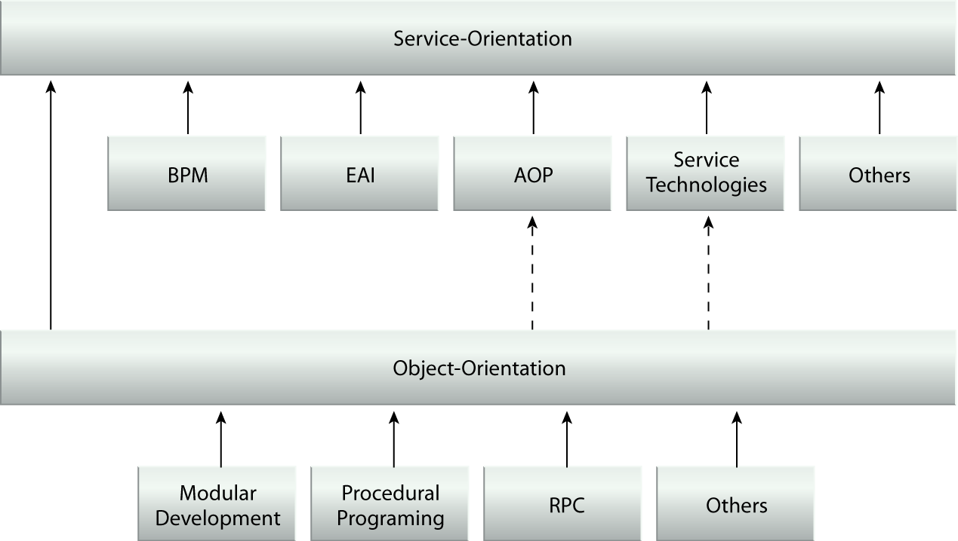
Origins of SOA

Slide 79
Benefits of SOA
Loosely-coupled architecture
Promotes architectural composability
Increases quality of service
Based on open standards
Supports vendor diversity
Increases reusability
Promotes organizational agility

Slide 80
SOA Technology Platform
The most common technology platform for realization of SOA is Web Services.
Web Service, basic standards:
XML
WSDL: Web Services Description Language
XSD: XML Schema Definition Language
SOAP: Simple Object Access Protocol
UDDI: Universal Description, Discovery, and Integration
WS-I Basic Profile

Slide 81
WS-* Extensions
WS-Addressing
WS-ReliableMessaging
WS-Policy
WS-Metadata Exchange
WS-Security
And many more

Slide 82
SOA Principles

Slide 83
Principles of SOA
Standardized service contract
Service loose coupling
Service abstraction
Service reusability
Service autonomy
Service statelessness
Service discoverability
Service composability

Slide 84
Standardized Service Contract
Services express their purpose and capabilities via a service contract.
In the form of:
WSDL definition
XML schema definition
WS-Policy description
Non-technical SLA, such as availability, response time usage statistics
Service contracts should be optimized, appropriately granular, and standardized to ensure that the endpoints established by the services are consistent, reliable and governable.

Slide 85
Service Loose Coupling
Service logic and implementation should be designed and evolved independently while still guaranteeing baseline interoperability with consumers.
Different levels of service coupling:
Service contract and underlying logic may be coupled to a parent business process
Service consumers are coupled to the service contract
Service logic is implemented in a proprietary vendor technology
Service logic may be coupled with multiple services it may need to compose
Service logic may be coupled to various resources that are part of the overall implementation environment.

Slide 86
Service Abstraction
Service abstraction enables loose coupling.
A service may encapsulate:
A legacy system
Custom components
Other services

Slide 87
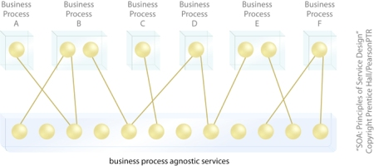
Service Reusability
Designing services that are agnostic to a specific business process increases their reusability.

Slide 88
Service Autonomy
Autonomy of a service is its ability to carry out its core service logic independently.

Slide 89
Service Statelessness
Management of excessive state information can compromise the availability of a service.

Slide 90
Service Discoverability
Services are supplemented with communicative meta data by which they can be effectively discovered and interpreted.

Slide 91
Service Composability
Services should be capable of participating as effective composition members, even if they don’t need to be immediately enlisted in a composition.
To solve a problem, its solution logic is decomposed into services. However, the ultimate, strategic benefits comes from the ability to continually recompose these services to solve additional problems in the future.
Complex service composition requires anticipating service design to avoid massive retro-fitting efforts.

Slide 92
Challenges Introduced by SOA
Design Complexity
Increased complexity of both the architecture and the design of individual services.
Increased performance considerations from the use of agnostic services.
Reliability issues of services at peak concurrent usage times.
Single point of failure for multiple processes from excessive reuse of agnostic services.
Service contract versioning issues.
Impact of potentially redundant service contracts.
Need for design standards
Need to enforce their compliance
Resistance to standardisation from architects and developers.

Slide 93
Challenges Introduced by SOA
Top-Down Requirements:
Need to design planned services, their relationships, boundaries, etc. upfront.
Imposes a significant amount of upfront analysis effort involving many business analysts and architects.
Time and budget constraints in creating such a blueprint upfront.
Counter-agile delivery.
Governance Demands:
Body of solution logic for a service does not belong to any one process. The team that delivers a service solution may not continue to own the service logic as it gets repeatedly used by other solutions, processes and compositions.
Therefore, special governance structures may be required, introducing new roles, processes and even departments.

Slide 94
SOA Project Lifecycle Stages
SOA Adoption Planning
Service Inventory Analysis
Service-Oriented Analysis (Service Modeling)
Service-Oriented Design (Service Contract)
Service Logic Design
Service Development
Service Testing
Service Deployment and Maintenance
Service Usage and Monitoring
Service Versioning and Retirement

